Slide 1
Football Friday Retail Promotion
By: Jennifer Trost, Dietetic Intern
Northwest Hospital, Aramark Distance Education Dietetic Internship

Slide 2
Purpose
Provide Dietetic Interns an opportunity to develop and implement a business plan

Slide 3
Company Summary
Northwest Hospital is located in Randallstown, Maryland
Acute-care general hospital
Owned and operated by Lifebridge Health- provider of health-related services, wellness and fitness services and educational programs
Approximately 250 bed capacity

Slide 4
Aramark & Northwest Hospital
Northwest signed a 2 year guaranteed net budget contract with Aramark in January/2015.
Aramark’s services include:
Patient services
Retail services
Catering
Uniforms

Slide 5
MISSION STATEMENTS
NORTHWEST HOSPITAL
TO IMPROVE THE WELL-BEING OF THE COMMUNITY BY NUTURING RELATIONSHIPS BETWEEN THE HOSPITAL, MEDICAL STAFF AND OUR PATIENTS
ALWAYS CREATE EXCEPTIONAL EXPERIENCES FOR THOSE WE SERVE
ARAMARK
DELIVER EXPERIENCES THAT ENRICH AND NOURISH LIVES

Slide 6
BUSINESS OBJECTIVES
Goal #1: Increase café sales with Football Friday theme day
Objective: Increase total café sales by 5% compared to the average sales from the previous non-payday Friday, October 16th
Goal #2: Increase café traffic with Football Friday theme day
Objective: Increase retail sales traffic by 5% as compared to the average traffic on previous non-payday Friday, October 16th
Goal #3: Increase checks average with Football Friday theme day
Objective: Increase checks average by 5% as compared to the check average on the previous non-payday Friday, October 16th
Goal #4: Send out “all-user” email with Football Theme Day flyer attached on October 29th to promote event.
Objective: Send out “all-user” email with Football Theme Day flyer attached on October 29th to promote event.

Slide 7
Competitors
All quick service restaurants
McDonald’s
Checker’s
Sonic
Taco Bell
Popeye’s Chicken

Slide 8
Price Comparisons with Competition
 | Old Court Café | McDonald’s | Checker’s | Taco Bell | Sonic | Popeye’s Chicken
Burrito Supreme |  |  |  | $3.19
Burger | $4.29 Angus Burger with Cheese | $3.79 Big Mac | $2.99 Checker Burger with Cheese | $3.89 Cheeseburger
Sandwich | $4.65 Grilled Chicken Sandwich, $4.09 Crispy Chicken Sandwich | $4.89 Artisan Grilled Chicken | $3.49 Spicy Chicken Sandwich |  | $4.69 Grilled or Crispy Chicken Sandwich | $5.49 Chicken Tender Sandwich
Value Meal/Combo | $5.99 - $6.49, 1 entrée, 2 sides, 20 oz. drink | $6.19 Big Mac, Medium Fries, Medium Drink | $6.49 Checker Burger with Cheese Small Combo | $6.29 Large Drink and Crunchy Taco Supreme | $6.19 Cheeseburger, Large Tots or Fries, Large Soft Drink | $5.29 2 PC Chicken Side, Bis/ Small Drink

Slide 9
SWOT Analysis
External | Strengths | Weaknesses
 | Variety, Visibility, Value-priced options, Healthy food and beverage options, Friendliness of café staff, Starbucks Coffee, Healthy for Life Program, Customer Loyalty, Convenience, Hours of Operation, Voice of the Consumer, Ambiance | Pricing, Wait time for food, Crowds/not enough seating
Internal | Opportunities | Threats
 | Ethnic Inspired Cuisines, Provide more incentives for Voice of the Consumer, More Theme-Based Meals/Promotions (National Sandwich Day, etc.), Sporting Event Celebrations, Convert customers who buy meals away from work or who bring meals from home | Nearby Competitors, Pricing, Weather, Economy

Slide 10
Aramark Survey
The most recent survey was completed in 2010 by Aramark and had 166 respondents with 21% being male, 73% female and 6% preferring not to answer.

Slide 11
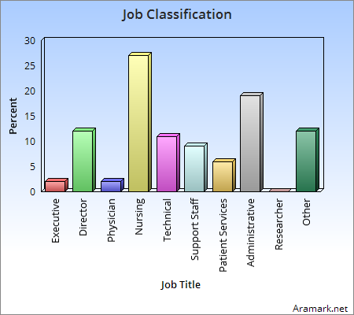
Market Segmentation The majority are in nursing and administrative positions

Slide 12
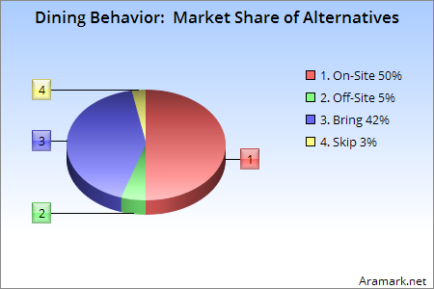
Market Segmentation Opportunity: Convert customers who buy meals away from work or who bring meals from home

Slide 13
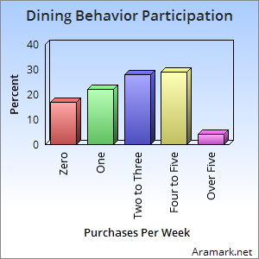
Market Segmentation Opportunity: Maintain heavy users while focusing on driving participation and frequency among medium and light users

Slide 14
Target Market
Employees of Northwest Hospital
Age range, 35-59
Baltimore Raven Fans

Slide 15
Marketing Strategy
Featured football themed foods based on playing teams- Baltimore Ravens and San Diego Chargers
Promotional event was held on October 30, 2015

Slide 16
Product, Place, Price and Promotion
Product: Fish Tacos, Crab Pretzels, Old Bay Wings, Buffalo Wings, & Fries
Place: Old Court Café
Price: Crab Pretzel- $5.99, Fish Tacos - $4.59, Smiley Fries - $1.99, Wing Bar with Celery and Bleu Cheese - $3.89, Combo Meal – Fish Tacos, Fries and Drink - $6.49
Promotion: Flyers were made on Microsoft Word, printed, and distributed to the mailboxes within the hospital, hand delivered to offices within hospital and across the street
All-user email was also sent out with an electronic version of the flyer

Slide 17
Employee Resources
Director (James Chambers) – Participated in team meeting to discuss event
Retail Manager (Pat Miller) – Participated in team meeting to discuss event, aided intern in obtaining sales data
Dietetic Intern (Jennifer Trost) – Developed promotional flyer, assisted with event
Cook (Stephen) – Oversaw production of menu items
Café Grill (Van, Frederick, Sabrina) – Served menu items to customers
Cashier (Rhonda) - Processed lunch transactions through register

Slide 18
Equipment Utilized
Cutting boards
Mixing Bowls
Knives
Spatulas
Conventional Ovens
Warmer
Pans
Fryer
Refrigerator
Can Opener
Corer
Sheet Pans
Tongs
Spoons

Slide 19
Food Resources
Items already in stock
Blue Cheese Dressing
Cream Cheese
Mayonnaise
Cod
Tortillas
Cabbage
Pretzels
Crab Meat
Celery

Slide 20
Food Resources
Items needed, ordered two days prior to event
Wings- $80.63
Smiley Fries - $30
Total - $111.63

Slide 21
Financial Resources
Labor costs did not change for this event – one employee was designated to oversee production of food

Slide 22
Cost Calculations
Sales, October 30th | Crab Pretzels | Fish Taco | Fish Combo | Wings | Fries | Total Sales Price for Items
Sales Price Per Item | $5.99 | $4.59 | $6.49 | $3.89 | $1.99 | $22.95
Number of Items Sold | 52 | 32 | 5 | 53 | 0 | 142
Variable Costs, October 30th
Labor per unit | $0.51 (6 hours x $12.00/hour = $72.00/142 meals)
Raw Food Cost | $4.84 (Fish Tacos = $0.83, Crab Pretzels - $3.20, Wings -$0.50, Fries - $0.31)

Slide 23
Evaluation of Goals
Goal #1: Increase café sales with Football Friday theme day as compared to October 16th
Objective: Increase total café sales by 5% compared to the average sales from the previous non-payday Friday, October 16th
Net Revenue | October 16th | October 30th
8.9% ↑ Increase | $2,299.55 | $2,506.39

Slide 24
Goal #2
Goal #2: Increase café traffic with Football Friday theme day
Objective: Increase retail sales traffic by 5% as compared to the average traffic on previous non-payday Friday, October 16th
Café Traffic | October 16th | October 30th
9.6% ↑ Increase | 457 Total Checks | 501 Total Checks

Slide 25
Goal #3
Goal #3: Increase checks average
with Football Friday theme day
Objective: Increase checks average
by 5% as compared to the check average
on the previous non-payday Friday,
October 16th.
Check Average | October 16th | October 30th
Goal Not Met | $5.03 | $5.04

Slide 26
Goal #4
Goal #4: Inform employees of Football Friday.
Objective: Send out “all-user” email with Football Theme Day flyer attached on October 29th to promote event and inform employees via hand-delivered flyers.
GOAL ACHIEVED!

Slide 27
What I would do differently
Production plan in place
Production meeting
Utilization of standardized recipes for everything offered
Focus on one item versus several, such as a specialty sandwich or burger

Slide 28
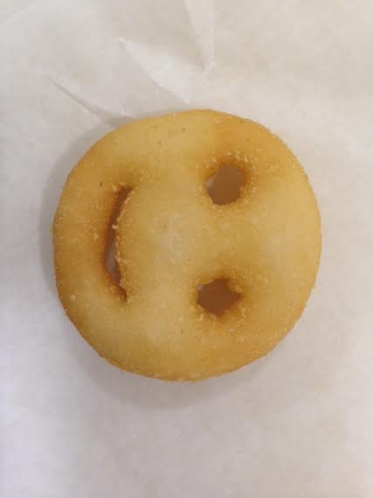
Questions?
Smiley Fry from retail event

